Slide 1
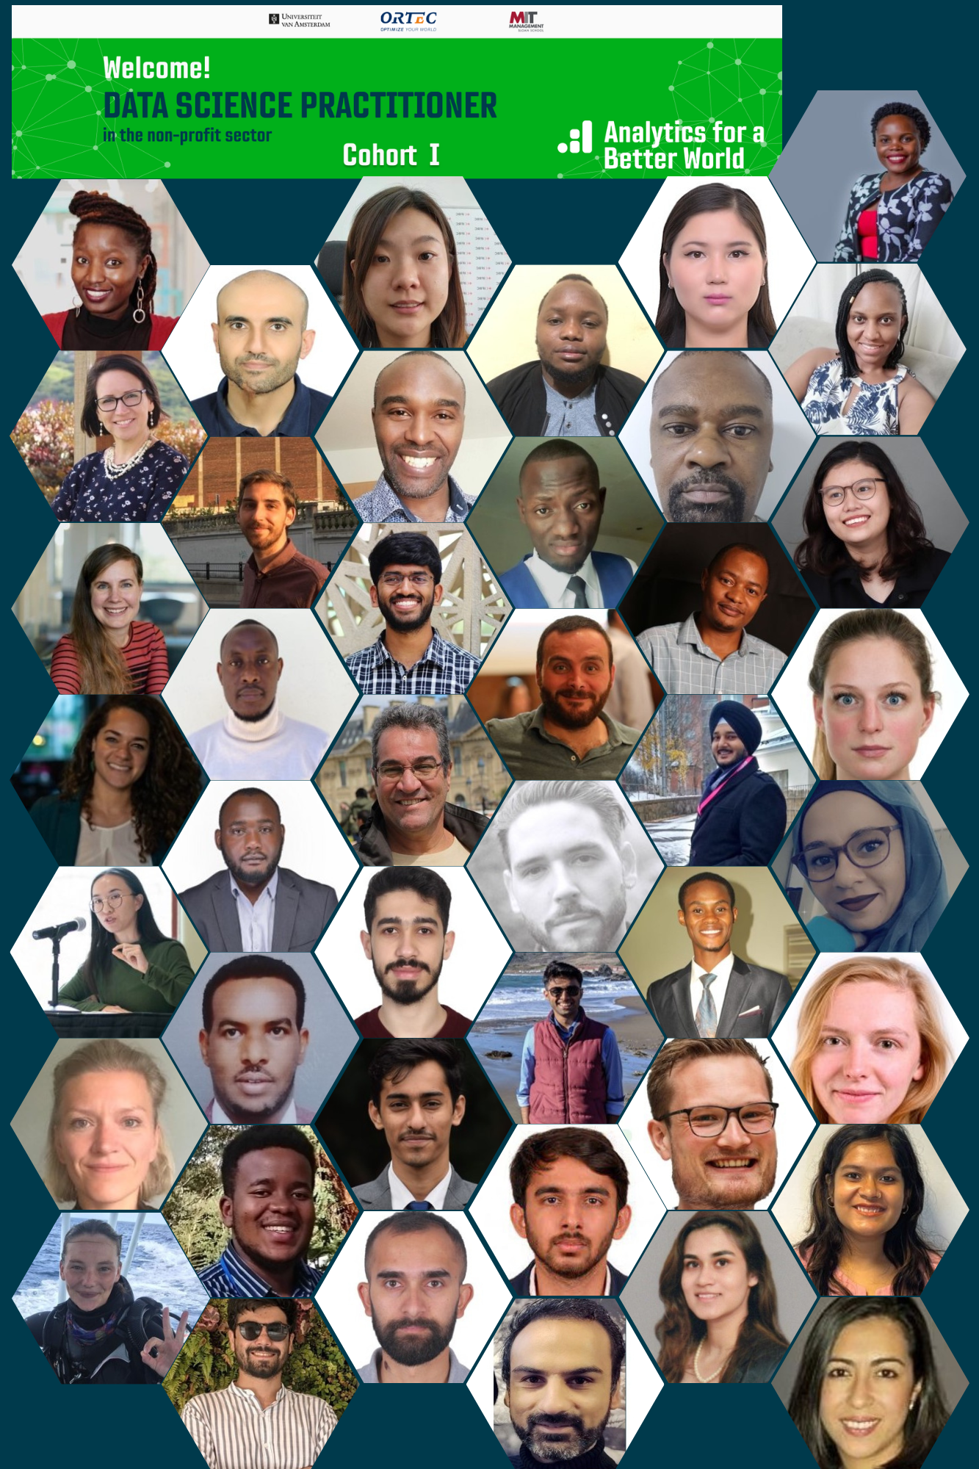
Data Science Practitioner
Fellowship Cohort 2022
Final Project Presentation
Instagram Sentiment Analysis
Marieke Meeske (Oxfam Novib)
Mentors: Konstantina Andronikou (Cmotions) & Claudia Orellana Rodriguez (ABW)
6th December 2022

Slide 2
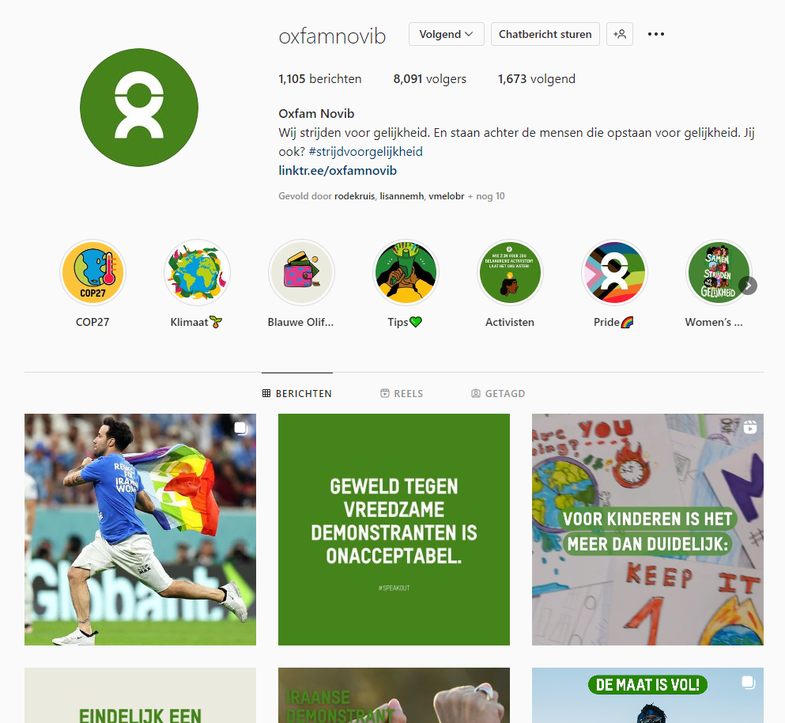
Business case
Instagram Sentiment Analysis
Background:
ONL implemented new brand identity (Q4 2021) with specific implementation focus on Instagram
Objective:
To provide input into new brand campaign evaluation using insights (incl sentiment) from Instagram
To provide input into supporters (followers / people engaged) as input for growth strategy (ia, how to find and engage ‘new followers’)
→ Given limit time period so far focused on objective 1

Slide 3
Methods or Tools Used
1. Download the data | 2. Clean the data | 3. Descriptive analysis | 4. Sentiment analysis
Using Instagrapi (open access with a regular Instagram account) Download ONL timeline: 01-01-2020 – 21-11-2022 (~2 yrs of old brand; ~1 yr of new brand) N= 289 Download comments associated with ONL timeline: Media post ID as input for comment harvest N= 960 (N= 680 for non-ONL comments) | Classification of ONL posts: Categories selected based on word cloud + organizational insights Categories assigned based on word patterns Comments: Model-based translation from NL to EN (using Googletrans API) Three levels of text cleaning Limited= removing mentions/URLs, apostrophe look-up only Stemmed= additionally, removing punctuation/special characters (but not emoji!)/capitalization/stop words, tokenization, stemming Lemmatized= additionally, removing punctuation/special characters (but not emoji!)/capitalization/stop words, tokenization, lemmatization | Timeline activity Engagement (nr of likes, nr of comments) | Using VADER (Valence Aware Dictionary and sEntiment Reasoner) Sentiment predictions on all three levels of cleaning Human assessment of the three predictions to pick one model Human annotation to evaluate prediction
https://github.com/adw0rd/instagrapi
https://github.com/cjhutto/vaderSentiment/blob/51c36d2f169f4590f0f827e2f9fb279f5aeb7114/vaderSentiment/vaderSentiment.py

Slide 4


Methods or Tools Used (Cont.)
VADER Model (sensitive to emojis, punctuation, capitalization) predicted the extent to which comments were positive/neutral/negative and combined this prediction into a compound score (from -1 (negative) to 1 (positive))
Manually verified model prediction (for sake of time only 1 annotator, subjective):
~75% of positive/negative model predictions match with human judgement
~40% of neutral model predictions match with human judgement
Model limitations: eg limited contextual interpretations of emojis (🔥, 🙌), and the longer the comment the more noise hence the more difficult to make an accurate prediction
-1
0
+1
Oh wat verschrikkelijk. Op NOS staat zojuist dat er 400 mensen buiten in de regen staan in Apel. Zijn er organisaties die tenten opzetten voor hen, maar die moeten afgebroken worden volgens de BOA'S. Belachelijk, onmenselijk en wreed. Dat dit in Nederland kan... om je rot te schamen!!! Een tent bieden is toch wel het minste wat er voor deze mensen gedaan kan worden.
Ik hoor een reclame van jullie op de radio, maar ik vraag me af of jullie je ook hebben uitsproken tegen de discriminatie van ongevaccineerden en tegen medische apartheid?
😍👏 wat een dag!!
😍😍😍😍😍😍😍😍😍😍😍

Slide 5
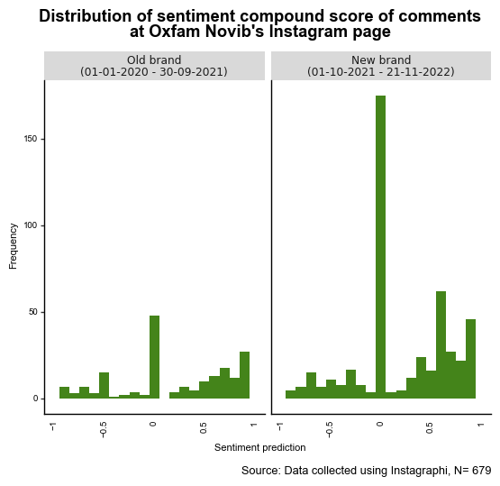
Results sneak peak
In the full timeline, 48% of comments predicted to be positive; 33% neutral; 19% negative. Given manual evaluation of sentiment prediction score, safe to say overall comments are positive, but don’t put much weight to the exact %.
Average sentiment in the ‘old brand’ period vs ‘new brand’ period is more or less similar (~0.19 vs ~0.23); no significant differences.
But, what does it mean? Negative comments can also mean someone being upset with xyz. Also, critical comments can be predicted to be neutral, while it can be positive that people engage on the matter in the first place. Nuance needed.

Slide 6
Most Significant Change (Expected)
Campaigns implemented by Oxfam Novib are benefitting from (freely available) data generated online, resulting in data-informed (social media) targeting and growth strategies.
By mobilizing a greater number of people because of data-informed strategies, we can jointly stand with people who are fighting inequality and together co-create a world that is fair, safe, equal and sustainable for everyone.

Slide 7

Key Learnings & Next Steps
Overall: inspiration!
Specific: sneak peak into the world of text mining. And by doing so enhancing my Python programming skills.
Next steps: integrating social media analytics into the research possibilities for Oxfam Novib’s Engagement department, including the scope of ‘Digital Monitoring & Evaluation (MEL)’.

Slide 8

Thank you for your attention!
https://analyticsbw.org/
https://www.linkedin.com/company/analytics-for-a-better-world/
academy@analyticsbetterworld.org

